Slide 1

Forecasting GMV – Unkown Company
Allan Romano

Slide 2
Agenda
Introduction
Estimates
Model selection
Q&A
Appendices

Slide 3
Introduction

Slide 4
Introduction | Objective
The objective of this business case is to develop an accurate model for revenue forecasting
while taking into account any valuable data patterns such as changes in trend, seasonality patterns,
holiday effects and explanatory variables.
This will boost digital marketing planning and performance tracking.

Slide 5
Introduction | Overview
With available daily data up until Jul 2020, I made 3 forecasts for future daily revenue.
Forecast 1: Only based on past behavior
Forecast 2: Including influence of ads spend
Forecast 3: Including influence of ads spend and conversion rate
As there is no future information for independent variables, I did 2 additional daily forecasts
Auxiliar forecast 1: Ads spend based only on past behavior
Auxiliar forecast 2: Conversion rate based only on past behavior

Slide 6
Introduction | Overview
Each forecast was made with the best possible model.
The best model was selected while looking for the least percentage error in a 2020 out of sample.
Summaries are presented at a midyear level to facilitate interpretation

Slide 7
Estimates

Slide 8
Estimates | 2020 H2 projection
Ads Spend
Revenue
Revenue / Spend
2019 H2
$1.82M
$5.38M
$2.95
2020 H1
$1.10M
$4.09M
$3.71
2020 H2
*forecast
$1.30M
$5.43M – $6.65M
$4.19 – $5.13
2020 H1 covid crisis caused 39% Spend reduction and 23% Revenue reduction vs 2019 H2.
However Revenue per $1 spent increased 25%. Cheaper and more effective digital marketing.
By 2020 H2 spend is expected to increase 18%, Revenue between 32% - 62% and
Revenue per $1 spent between 12% - 38%

Slide 9
Estimates | Revenue | monthly avg
Historical ~45% increase trend
broke in 2020H1
By 2020 H2 Revenue is expected
to increase between 32% - 62%
By 2020 H2 Revenue will increase
between 1% - 23% vs 2019 H2

Slide 10
Estimates | Revenue / spend | monthly avg
After continuous decreases, Revenue
per $1 spent stabilized in 2019
and increased 25% by 2020 H1
By 2020 H2 Revenue per $1 spent
is expected to increase between
12% - 38%
2020 H1 crisis unlocked efficiency
in digital marketing spending

Slide 11
Estimates | Ads Spend & Effective Conversion Rate | monthly avg
By 2020 H2 Ads spend is expected to increase 17% vs 2020 H1
By 2020 H2 Effective conversion Rate is expected to decrease -3% vs 2020 H1
Business plans on Spend and Conversion Rate may be included to boost Revenue forecasts

Slide 12
Estimates | Business Recommendations
Depending on the product type and market penetration
Assuming high market penetration
Focus on developing existing clients
Increase in Ads Spend focusing on specific segments
Experimentation to detect best campaign desitions (AB testing)
Adquisition cost is high and must be compared with clients LTV
Assuming early and low market penetraiton
Focus on acquiring new customer
Increase Ads Spend in general
Lift in revenue is expected when increasing spending
Customer adquisition cost is low

Slide 13
Estimates | Business Recommendations
Customer segmentation
Its important to always focus on most profitable products and customers
Target segments with performance above the mean estimated revenue

Slide 14
Model Selection

Slide 15

Model Selection | Definition & Advantages
Prophet forecasting procedure
A time series model with 3 components: trend (g), seasonality (s) and holiday effects (h).
Advantages
Easy to interprete
Trend changepoints
Multiple seasonalities with multiple periods
Holiday and recurrent event effects
Bayesian parameter estimation with low memory quasi Newton method

Slide 16
Model Selection | Error testing
Success criteria
Minimize the mean Absolute Percentage Error in the following 30 days
Estimate the model using data until 2019
Forecast values for 2020
Compute MAPE of estimations against real values
Testing procedure
A least error model was only searched for the Revenue cases.
Auxiliar models for spend and conversion rate where selected through a graphic inspection.

Slide 17
Model Selection | Error testing
CV MAPE
Revenue models
Including both Ads Spend and Conv
Rate leads to the best model among all
with a 1-month error of 22.9%
Not including any variable leads to the
worst model with a 1-month error of 27.5%
Revenue wo explanatory variables
27.53%
Revenue = f(ads spend)
26.87%
Revenue = f(ads spend, effective conversion rate)
22.93%
Auxiliar models
Auxiliar forecast where not optimized
in error and where selected using
graphical inspection
Ads spend wo explanatory variables
67.71%
Effective conversion rate wo explanatory variables
34.40%

Slide 18
Model Selection | Further improvements
Next steps
Business input
Interview with model users, get feedback and understand additional requirements
Include business plannings or expectations about spend and conversion rate.
Performance measures
Strengthen error measurement with time series cross validation over larger periods
Include uncertainty intervals and coverage to meassure performance
Model selection
Explore additional variables or indicators to increase performance
Explore additional non regular seasonalities for better fitting
Include additional holidays and recurrent events that may affect revenue
Optimize macro parameters selection
Model implementation
Automation of the model estimation and forecasting

Slide 19
Q&A? or Appendices?
Allan Romano

Slide 20
Appendix Variable Selection

Slide 21
Variable Selection | Ads Spend
Correlation with Revenue: 78.02%

Slide 22
Variable Selection | Effective Conversion Rate
Correlation with Revenue: 54.22%
Correlation with Revenue: 25.05%

Slide 23
Appendix Component graphs

Slide 24
Model 1

Slide 25
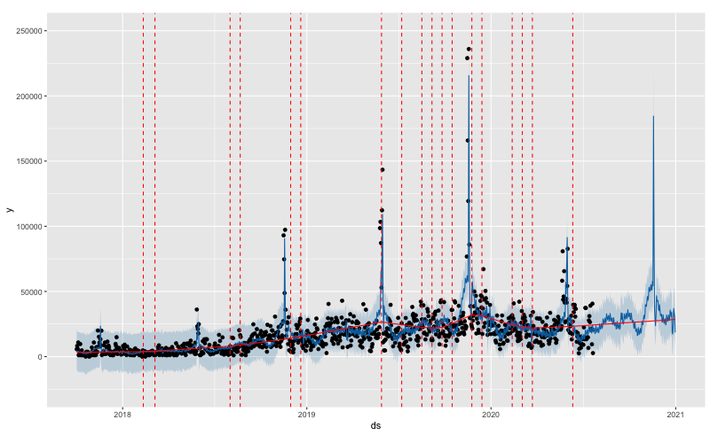
Model 1 | Trend
Changeponits all over the
sample to ensure learning
from the change in trend
observed in 2020 H1
Included holiday effects to
learn from spikes observed in
the last days of May and
November

Slide 26
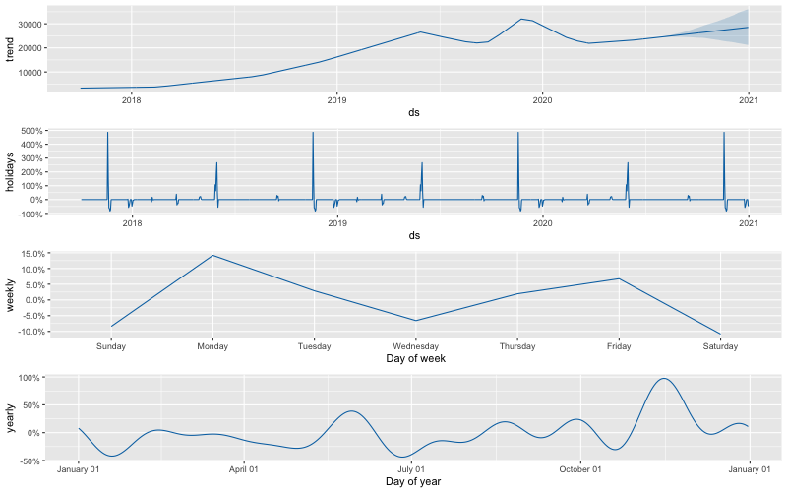
Model 1 | Seasonality & Holidays
Detected seasonal effects
Weekly: increases in Mon and Fri
Yearly: increases in May and Nov

Slide 27
Model 2

Slide 28
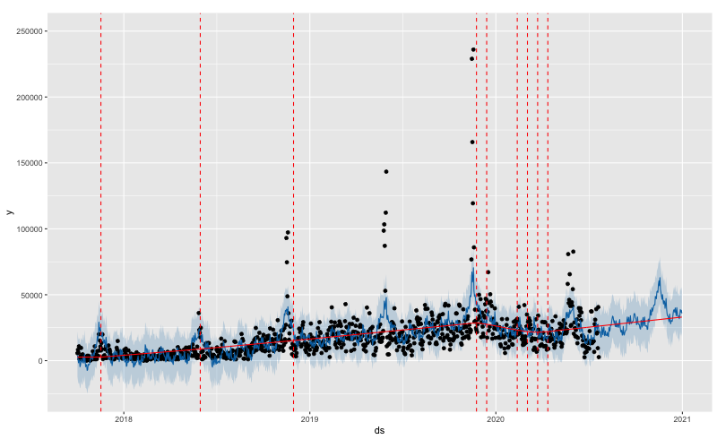
Model 2 | Trend
Changeponits all over the
sample to ensure learning
from the change in trend
observed in 2020 H1
Included holiday effects to
learn from spikes observed in
the last days of May and
November

Slide 29
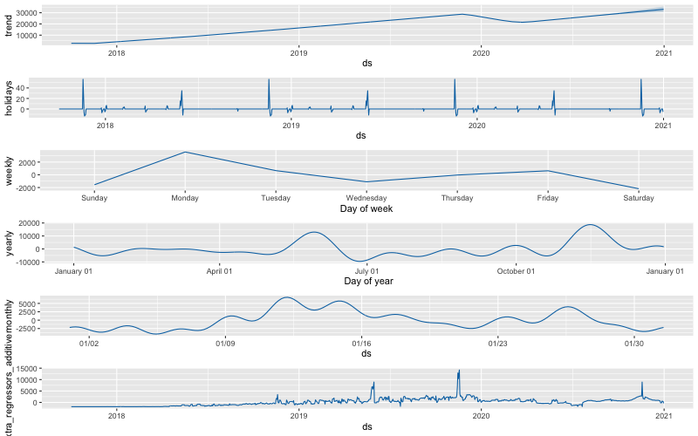
Model 2 | Seasonality & Holidays
Detected seasonal effects
Weekly: increases in Mon and Fri
Yearly: increases in May and Nov
Monthly: increases around the
10th and 25th days

Slide 30
Model 3

Slide 31
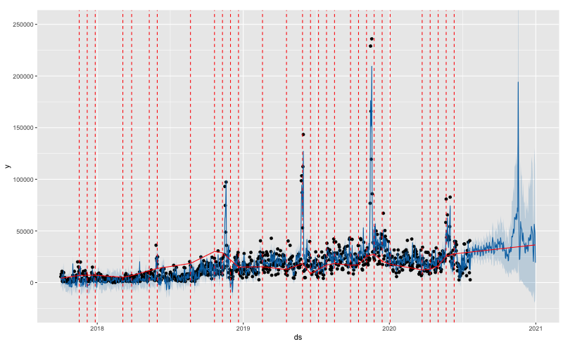
Model 3 | Trend
Changeponits all over the
sample to ensure learning
from the change in trend
observed in 2020 H1
Included holiday effects to
learn from spikes observed in
the last days of May and
November

Slide 32
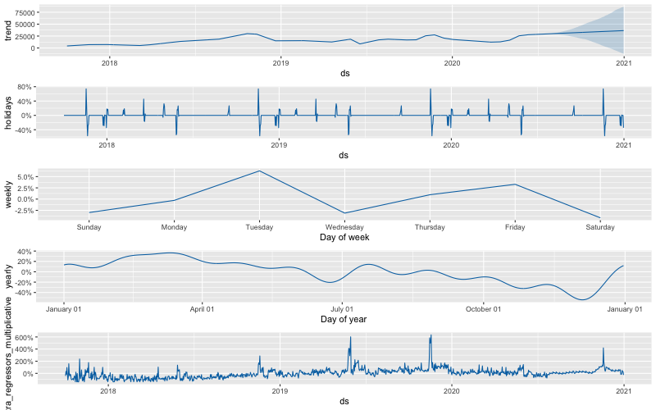
Model 3 | Seasonality & Holidays
Detected seasonal effects
Weekly: increases in Tue and Fri
Yearly: no increases in May
and Nov as they are learnt from
regressors

Slide 33
Auxiliar Model 1

Slide 34
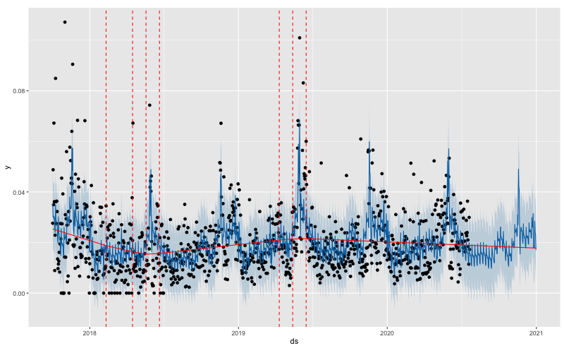
Auxiliar Model 1 | Trend
Changeponits only before
2020 H1 to get a stable
forecast in terms of trend
Included holiday effects to
learn from spikes observed in
the last days of May and
November

Slide 35
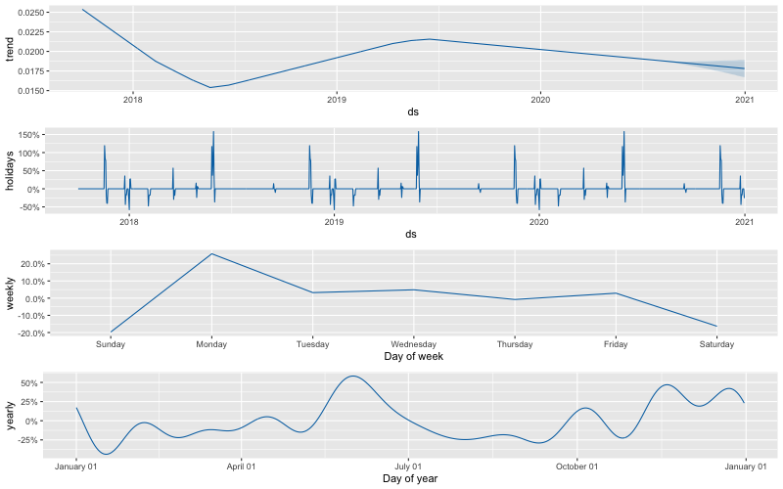
Auxiliar Model 1 | Seasonality & Holidays
Detected seasonal effects
Weekly: increases in Mon and Fri
Yearly: increases in May and Nov

Slide 36
Auxiliar Model 2

Slide 37
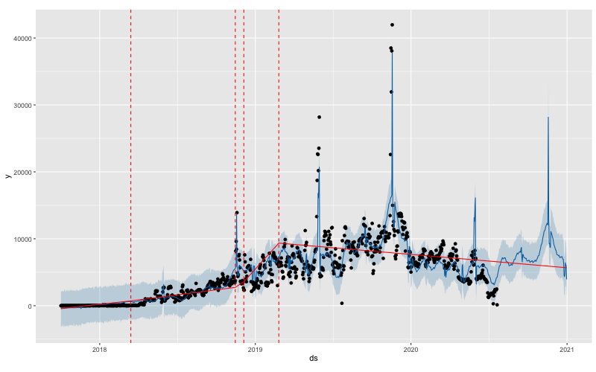
Auxiliar Model 2 | Trend
Changeponits only before
2020 H1 to get a stable
forecast in terms of trend
Included holiday effects to
learn from spikes observed in
the last days of May and
November

Slide 38
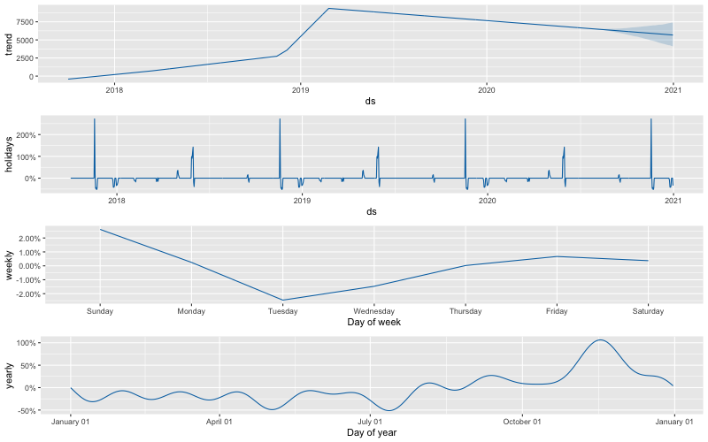
Auxiliar Model 2 | Seasonality & Holidays
Detected seasonal effects
Weekly: increases in Sun and Fri
Yearly: increases in Nov

Slide 39
Appendix Forecast graphs

Slide 40
Model Graphs | Daily Revenue forecasts

Slide 41
Model Graphs | Daily Ads spend forecast

Slide 42
Model Graphs | Daily Effective Conversion Rate forecast

Slide 43
Appendix Model Definition

Slide 44





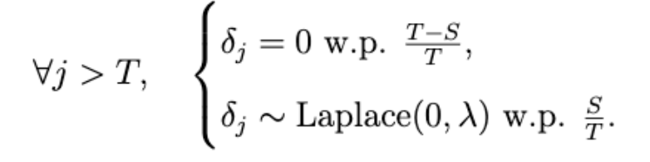
Model definition | Components
A descomposable time series model with 3 components: non linear trend (g),
non linear seasonality (s) and holiday effects (h).
Trend component
a: indicator of changepoints
delta: magnitude of changes in trend
m, gamma: to make the function continuous

Slide 45
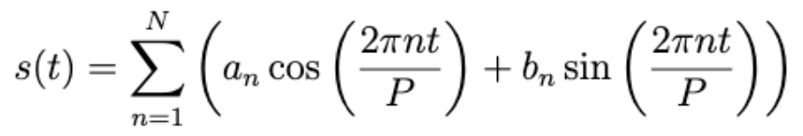







Model definition | Components
Seasonality component
beta: components of fourier series
N: order of fourier series
Holidays component
Other parameters

Slide 46
Model definition | Components
Parameter estimation
Bayes estimator: maximum likelyhood a posteriori estimator
Quasi Newton method: limited memory BFGS

Slide 47
Appendix Error Testing

Slide 48
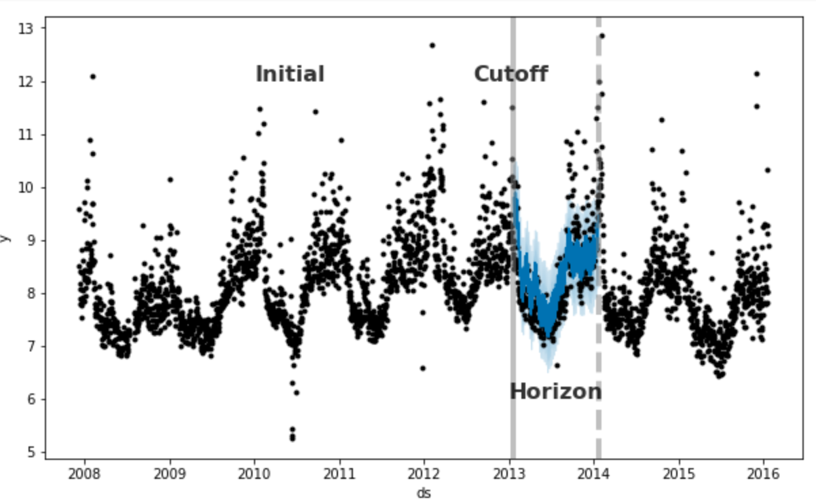
Error Testing | Example

Slide 49
Appendix Fourier Series

Slide 50
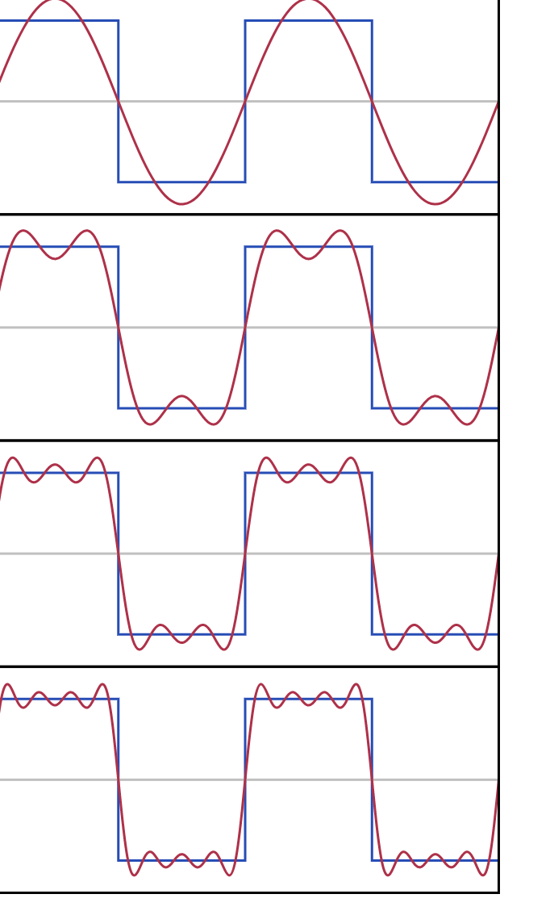
Fourier Series | Example

